Slide 1
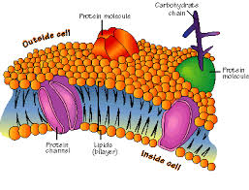
Chapter 2 Notes
Chemistry of Life
Enzymes

Slide 2
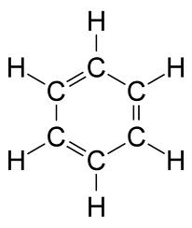
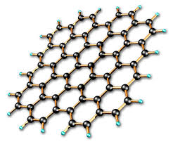
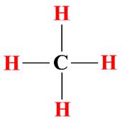
Carbon
Carbon is in 99% of all organic (inside living systems) molecules
Carbon is unique because
Makes 4 bonds
Bonds with different elements
Bonds with itself to make rings, chains, etc…

Slide 3
Macromolecules
Biological macromolecules are polymers that support life
Polymers are large molecules made up of small sub units.
Analogy: Puzzle is made up of many puzzle pieces
4 Organic macromolecules make up life

Slide 4
Carbohydrates
Ratio of C:H:O 1:2:1
Function: main energy source + cell marker
Polymer = Starch, glycogen
Monomer = monosaccharide (glucose)

Slide 5
Lipid
C, H, and O
Not soluble in water
Stores energy, act as steroids and make up biological membranes
Polymer = Lipid
Monomer = glycerol + fatty acid
Come in saturated (single bonds) and unsaturated (double bonds)

Slide 6
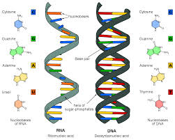
Nucleic Acids
C, H, O, N, P
Store and transmit genetic information
Example is DNA and RNA
Polymer: nucleic Acid (DNA, RNA)
Monomer: nucleotide

Slide 7
Proteins
N, C, H, O
Enzymes (Speed up reactions), Cellular channels, hormones
Polymer: Protein
Monomer: Amino Acid
20 types of amino acids (all with different shape or charge)
Change a protein by changing the number and sequence of the amino acids

Slide 9
Enzymes
Proteins
Job: speed up chemical reactions by lowering the activation energy
Specific to the molecule(substrate) they work on
Each type of enzyme can only work on one type of molecule

Slide 10
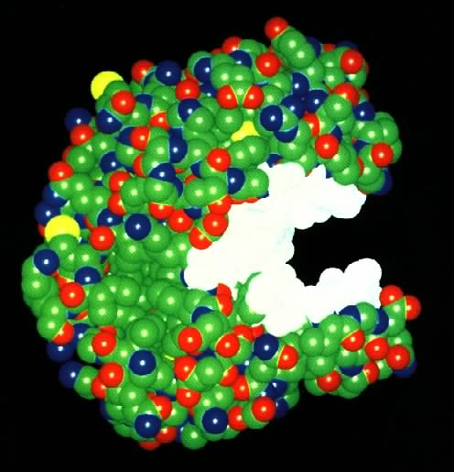
What Are Enzymes?
Most enzymes are Proteins
Act as Catalyst to speed up a reaction
Not permanently changed in the process

Slide 11
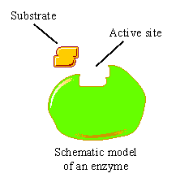
Enzymes
Are specific for what they will catalyze
Are Reusable
End in –ase
-Sucrase
-Lactase
-Maltase

Slide 13
Enzyme-Substrate Complex
The substance (reactant) an enzyme acts on is the substrate
Substrate
Joins
Enzyme

Slide 14
Active Site
A restricted region of an enzyme molecule which binds to the substrate.
Substrate
Enzyme
Active Site

Slide 15
What Affects Enzyme Activity?
Three factors:
1. Environmental Conditions
2. Cofactors and Coenzymes
3. Enzyme Inhibitors

Slide 16
1. Environmental Conditions
1. Extreme Temperature are the most dangerous
- high temps may denature (unfold) the enzyme.
2. pH (most like 6 - 8 pH near neutral)
3. Ionic concentration (salt ions)

Slide 17
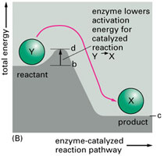
How do enzymes Work?
Enzymes work by weakening bonds which lowers activation energy

Slide 18
Enzymes
Without Enzyme
With Enzyme
Free
Energy
Free energy of activation
Reactants
Products
Progress of the reaction

