Slide 1
NOTEBOOK SET UP WARM UPS
Notebook set up
crossword

Slide 2
Good Morning – Warm up
Take out composition notebook and have it on your desk
Take out something to write with
If you do not have the notebook – take out a sheet of paper in order to take notes on how to set up the notebook

Slide 3
Set up – page #1
Title page – 1st side of 1st page (taking up the entire page)
Biology
Period 5
Mr. Haring
John Smith (your name)
1

Slide 4
Set up – Page #2
Page 2 – 1st side (taking up the entire page- 2 columns)
Table of contents
2
Assignment | Page #

Slide 5
Set Up – page #2
Leave the back of page 2 + 3 pages front and back (total of 6 more sides) for the table of contents

Slide 6
Warm Up #1

Slide 7
Cnotes Science and Experimentation

Slide 8
Add to table of contents
Add page 1, 2 and 3 title and page number to table of contents
Assignment | Page #
Title Page | 1
Table of Contents | 2
Warm Up #1 | 3
C-notes – Scientific Method and experimentation | 4

Slide 9
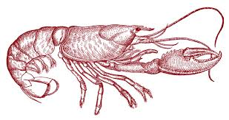
Warm Up #1 A
For two of your observations Example
Make a Observation/Claim/Evidence/Justification- Chart
Observation | Claim | Evidence | Justification
1. Lobster has large multi-segmented tail which works under the lobster | The lobster swims backwards to avoid predators or move | Tail segments curve downward, segments is hard exoskeleton | Lobsters live in a very predator rich environment and need protection. Eyes and clays forward tail propels backwards

Slide 10
Warm Up #1 B
Design an experiment that would show whether one type of food was better than another at helping an animal grow faster. Write the procedure (step by step directions) Make sure to limit to one variable and discuss how they will collect the data

Slide 11
Table of Contents
ASSIGNMENT | PAGE #
Title Page | 1
Table of Contents | 2
Warm Up #1 | 3
C-notes: Scientific Method and experimentation | 4
C-Notes: Characteristics of living things and tools | 5
Warm Up #2 | 6

Slide 12
Argument
F /1 /10
Highlight the statements and put the code in the margins
C /1 Viruses are ……………
E1 /2
E2 /2
J1 /2
J2 /2

Slide 13
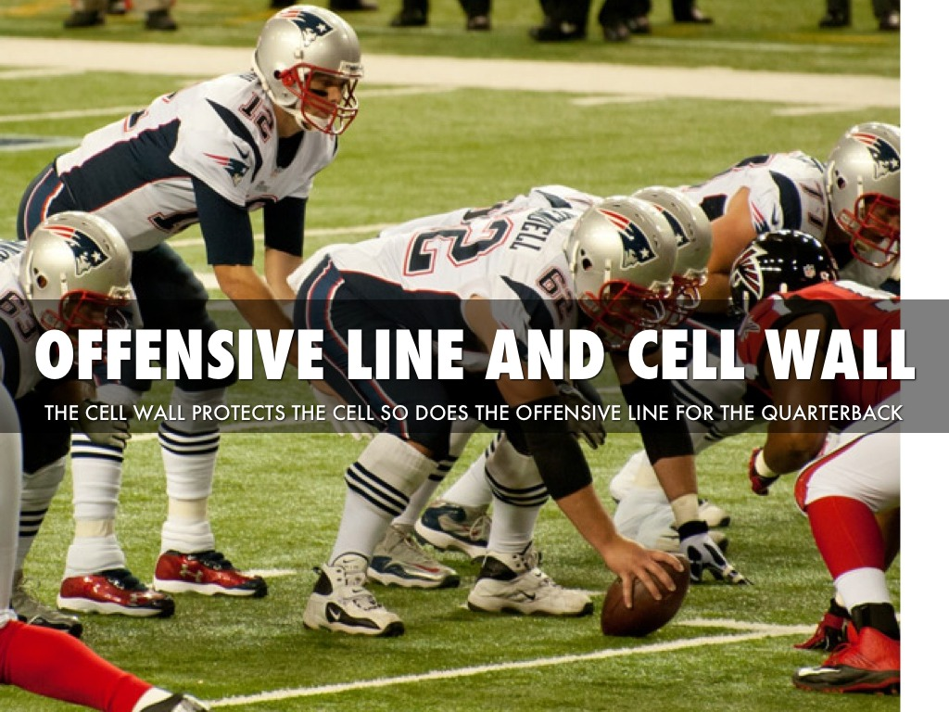
Warm up #1 C
1. Pick 3 of your vocabulary words and draw an analogy which depicts the meaning. Label your drawing and explain why it works

Slide 14
Warm Up #2 A
State your argument (claim, evidence and justification) for the questions should viruses be classified as a living thing?

Slide 15
Warm Up#2 B
List 5 characteristics of Life and explain how a Elephant display these characteristics.
Quietly study for the Chapter 1 Test

Slide 16
Table of Contents
Assignment | Page #
C-Notes: Characteristics of living things and tools | 5
Warm Up #2 | 6
C-Notes: Macromolecules | 7
Warm Up #3 | 8
C-Notes: Enzymes | 9
Notebook Grade Sheet #1 | 10

Slide 17
Warm Up #2 C
C6H12O6 + 6O2 → CO2 + H2O
Write everything you know about this equation. Include the compounds involved, how many atoms of each element and balance if you can.
Explain what you know about atoms and molecules

Slide 18
Warm Up #3 A
List the 4 Organic Macromolecules
Next to each state the monomer that makes them up. (If they have one)
Write which elements make each up (Hydrogen, Oxygen, etc….)
State their functions in a living cell

Slide 19
Warm Up #3 B
How could we build the glucose, saturated fatty acid and the amino acid all with the same model kit?
What were their similarities and what were their differences?
“Feed a pig an apple and he turns it into bacon” Explain how this is correct.

Slide 20
Notebook Grade Sheet
Total Points = 28
Assignment | Needed to Get Points | Points
Title Page | Neat (Name, Period, Biology) | /2
Table of Contents | Filled out ½ (All pages Numbered- lower corner) ½ | /2
Warm Up #1 Warm Up #2 Warm Up #3 | 3 complete (1 point each) 3 Complete (1 point each) 2 Complete (1 point each) | /3 /3 /2
Notes Scientific Method and experimentation | 4 Q (1/2 ) 4Sum (1/2) | /4
Notes: Characteristics of living things and tools | 4 Q (1/2 ) 4Sum (1/2) | /4
Notes: Macromolecules | 4 Q (1/2 ) 4Sum (1/2) | /4
Notes: Enzymes | 4 Q (1/2 ) 4Sum (1/2) | /4

Slide 21
Warm Up #3 C
Describe how an enzyme and a substrate are like a key and a lock. List at least 3 similarities.
Sketch the graph of an chemical reaction with out an enzyme and then with an enzyme. Label the activation energy and the reactants and products.

