Slide 1
Warm Up Chapter 8
Page 17

Slide 2
Warm up page 17 (1/3)
Define + draw an analogy of…..
Autotroph
Pigment
Light Dependent Reaction

Slide 3
Warm Up (2/3) – page 17
Draw an ATP molecule
Label the 3 parts
Draw an arrow showing where most of the energy is store
State 3 reasons why we need to convert all energy into ATP (what is it used for)
Draw an analogy showing ATP and ADP

Slide 4
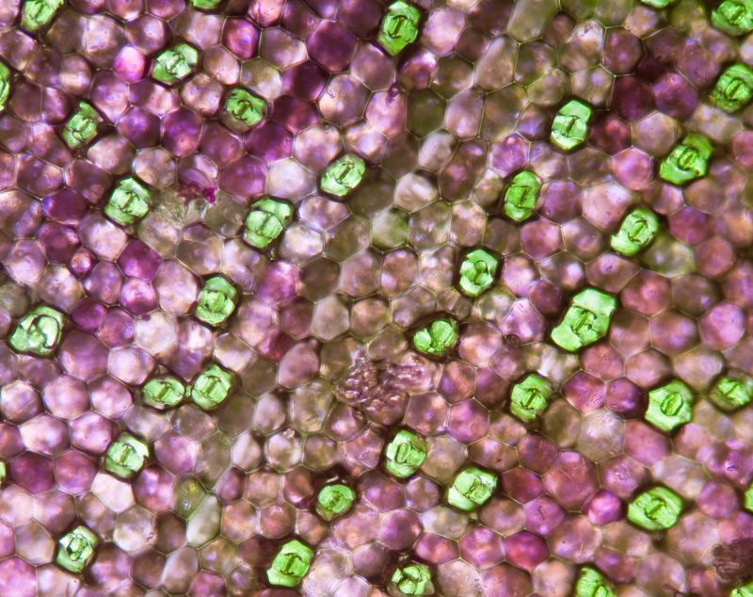

Slide 5
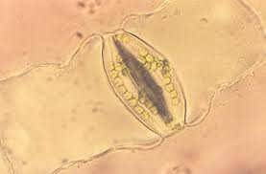
Guard Cells
Inner Cell Wall

Slide 6
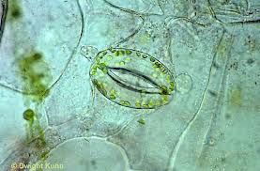
Page 597
Stoma

Slide 7
Test 7 Review
Please write all missed questions with the correct answer. If it is a picture sketch the organelle and label it (10 questions)
Example:
All living things are composed of: (D)cells

Slide 8
Warm Up (page 17 3/3)
Chlorophyll a appears blue-green. Which colors does chlorophyll a reflect? Which colors does it absorb?
The following terms are mixed up. Please write a reaction (reactants → products) trying to place in the correct order.
CO2, Oxygen, →, sunlight, sugar, water

Slide 9
Table of Contents
Assignment | Page #
Cell Drawing | 13
Warm Up: Chapter 7 | 14
Grade Sheet notebook 2 | 15
Notes: Osmosis | 16
Warm Up C. 8 | 17
Test 7 Review | 18
Notes 8.1 Energy Transfer | 19

Slide 10
Assignment | Page #
Notes: Osmosis | 16
Warm Up C. 8 | 17
Test 7 Review | 18
Notes 8.1 Energy Transfer | 19
Video Notes: Photosynthesis | 20
Notes 8.2 Photosynthesis discovery | 21
Warm up Chapter 8/9 | 22

Slide 11
Table of Contents
Assignment | Page #
Notes 8.2 Photosynthesis discovery | 21
Warm up Chapter 8/9 | 22
Notes 8.3 Process of Photosynthesis | 23
Photosynthesis Writing Task | 24
Notes 9.1 Cell Respiration Overview | 25
Notes 9.2 Cell Respiration wrap up | 26
Cell Respiration Writing | 27

Slide 12
Warm Up page 22 (1/3)
Draw and label 3 pictures showing the 3 experiments that uncovered the key components of photosynthesis (water, oxygen and light)

Slide 14
Warm Up page 22 (2/3)
Draw the Chloroplast diagram and label all 11 key boxes. Remember to think in terms of 2.
ADP
NADPH
Calvin Cycle
ATP
Light Dependent Reaction
Light
Oxygen
CO2
NADP+
Sugar
Water

Slide 15
Warm Up page 22 (3/3)
Draw the Cellular Respiration diagram and label all 9 boxes. Also label the cytoplasm and the mitochondria.
Glycolysis
Electron Transport Chain
Krebs Cycle
Glucose
2 Pyruvic Acid
CO2
NADH
FADH2
ATP
Cytoplasm
Mitochondria

Slide 16
Warm up
Finish Cornell notes for chapter 8 and 9 notes
5 questions
5 sentence summary

