Slide 1
Warm Ups Chapter 12

Slide 2
Warm Up 12 (1 of 3)#
List everything you know about DNA

Slide 3
Test Review 11#
Rewrite all questions you missed up to 10. Answer them completely with a short explanation why
Or
2. Rewrite all questions you missed + important questions up to 10 questions with an explanation why

Slide 4
Table of Contents
Assignment# | Page #
Notes 11.4 Meiosis | 42
Lab Exploration: Meiosis | 43
Critical thinking Questions | 44
Warm Up Chapter 12 | 45
Test Corrections 11 | 46
Notes DNA 12.1 | 47
Notebook Check | 48
Notes: DNA Replication | 49
Activity: Replication Questions | 50
Notes:
Warm Up Chapter 12
38
Test 11 Review
39
Notes 12.1 DNA discovery
40

Slide 5
Warm Up (2/3)#
Draw out how Hershey- Chase or Griffith and Avery proved that it was DNA not proteins that was the genetic material

Slide 6
Notebook Grade Sheet#
Activity | Description (needed to get points) | Points
Neatness | (page #, titles, neat, TOC) | 5
Warm Ups | Page 33 | 3
 | Page 40 | 3
Notes | 11.1 intro to Genetics | 5
 | Probability | 5
 | 11.3 Beyond Mendel (part 1 and 2) | 5
 | 11.4 Meiosis | 5
Lab/ Activities | Bird Count: Weather, time, birds, number | 4
 | Analysis of Human Build (1/2 a child, chart) | 3
 | Lab Exploration: 5 phases of Meiosis 1 | 2
Total |  | 40

Slide 7
Table of Contents#
Assignment | Page #
Notebook Check | 48
Notes: DNA Replication | 49
Activity: Replication Questions | 50
Notes: Protein Synthesis | 51

Slide 8
Warm Up 12 (3 of 3)#
Diagram DNA Replication
Label the following parts
Helicase
Replication Fork
DNA Polymerase
Old Strand / New Strand
Use Base Letters to show you understand Complementary bases

Slide 9
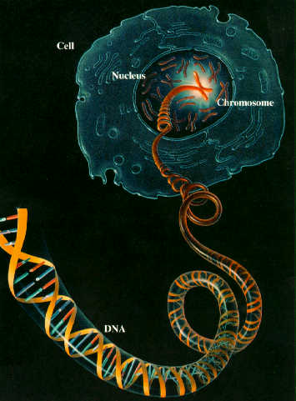

Slide 10
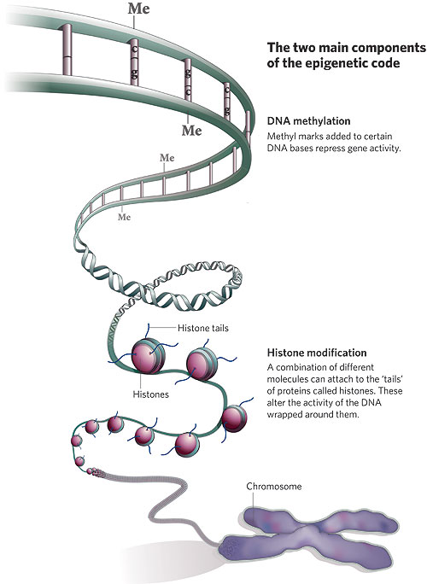
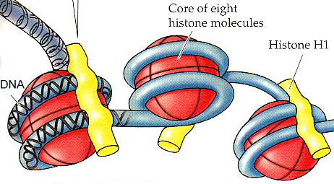

Slide 11
Warm Up 12 (3/3)
List and Explain the 4 major steps to extracting your DNA (use words like lysis, protease, nucleus, harvest cells, salt, membranes, precipitate, alcohol, etc..)
Do liver cells and check cells contain the same DNA? Explain how they would have different functions!

Slide 12
Table of Contents
DNA Lab: Reading questions | 42
Notes 12.2 DNA Replication | 43
Warm Up 12 | 44
Notes: Central Dogma | 45

Slide 13
Warm Up 12 (2/3)

Slide 14
Using Page 303 find the Amino Acid
UUC
UAC
3. DNA: TTCAGCCCGAATTTTACT
mRNA:
Amino A:
4. Tryptophan, Histidine, Methionine, Lysine – State the mRNA and then the DNA sequence (possible)

